Slide 1
Modernización CICS Creación y uso de APIs para una integración eficiente
Diego Rodríguez Bravo
Technical Consultant
Broadcom MSD
diego.rodriguez@broadcom.com

Slide 2
Disclaimer
Certain information in this presentation may outline Broadcom’s general product direction. This presentation shall not serve to (i) affect the rights and/or obligations of Broadcom or its licensees under any existing or future license agreement or services agreement relating to any Broadcom software product; or (ii) amend any product documentation or specifications for any Broadcom software product. This presentation is based on current information and resource allocations as of March 25, 2025, and is subject to change or withdrawal by Broadcom at any time without notice. The development, release and timing of any features or functionality described in this presentation remain at Broadcom’s sole discretion.
Notwithstanding anything in this presentation to the contrary, upon the general availability of any future Broadcom product release referenced in this presentation, Broadcom may make such release available to new licensees in the form of a regularly scheduled major product release. Such release may be made available to licensees of the product who are active subscribers to Broadcom maintenance and support, on a when and if-available basis. The information in this presentation is not deemed to be incorporated into any contract.
Broadcom may use any feedback provided by you related to a Broadcom product or this presentation for any Broadcom business purposes (including but not limited to, preparation, reproduction, and distribution of derivative works based upon such feedback), without any obligation to you including consent or payment.
Copyright © 2025 Broadcom. All rights reserved. The term “Broadcom” refers to Broadcom Inc. and/or it’s subsidiaries. Broadcom, the pulse logo, Connecting everything, CA Technologies and the CA Technologies logo are among the trademarks of Broadcom.
THIS PRESENTATION IS FOR YOUR INFORMATIONAL PURPOSES ONLY. Broadcom assumes no responsibility for the accuracy or completeness of the information. TO THE EXTENT PERMITTED BY APPLICABLE LAW, BROADCOM PROVIDES THIS DOCUMENT “AS IS” WITHOUT WARRANTY OF ANY KIND, INCLUDING, WITHOUT LIMITATION, ANY IMPLIED WARRANTIES OF MERCHANTABILITY, FITNESS FOR A PARTICULAR PURPOSE, OR NONINFRINGEMENT. In no event will Broadcom be liable for any loss or damage, direct or indirect, in connection with this presentation, including, without limitation, lost profits, lost investment, business interruption, goodwill, or lost data, even if Broadcom is expressly advised in advance of the possibility of such damages.

Slide 3
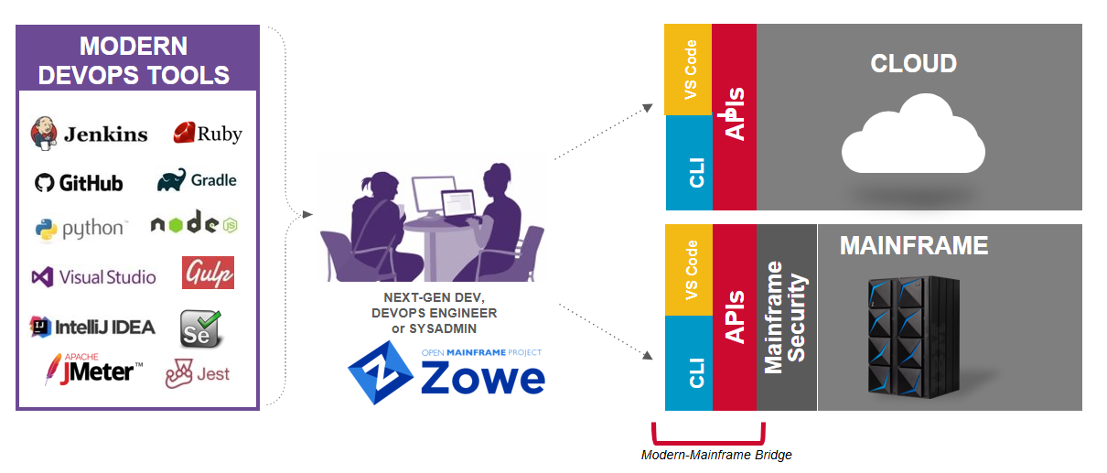
The Open Mainframe Advantage
Notes:
El mainframe es la tecnología más moderna y duradera. Su fiabilidad, escalabilidad y adaptación la hace ser la plataforma por excelencia.
El mainframe ha estado en un silo durante muchos años

Slide 4
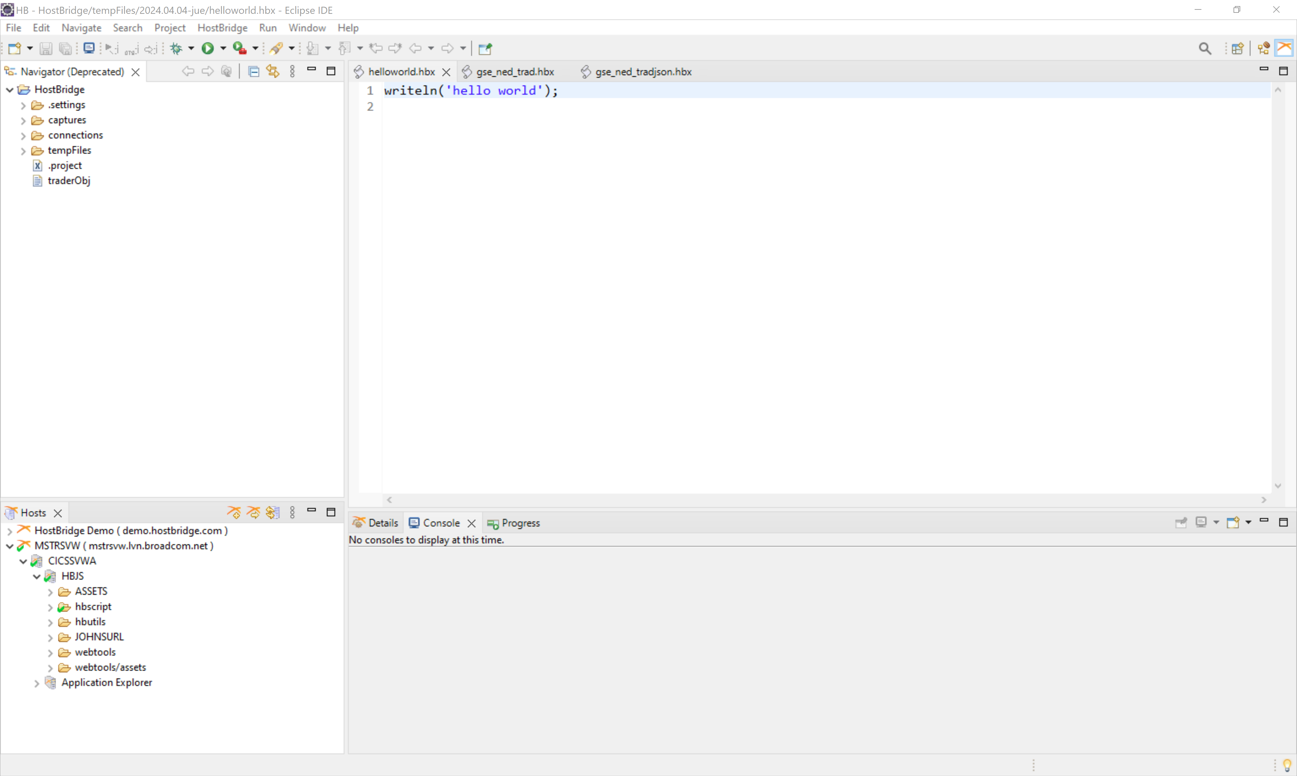
ECLIPSE IDE

Slide 5

VSCode
Zowe Explorer

Slide 6
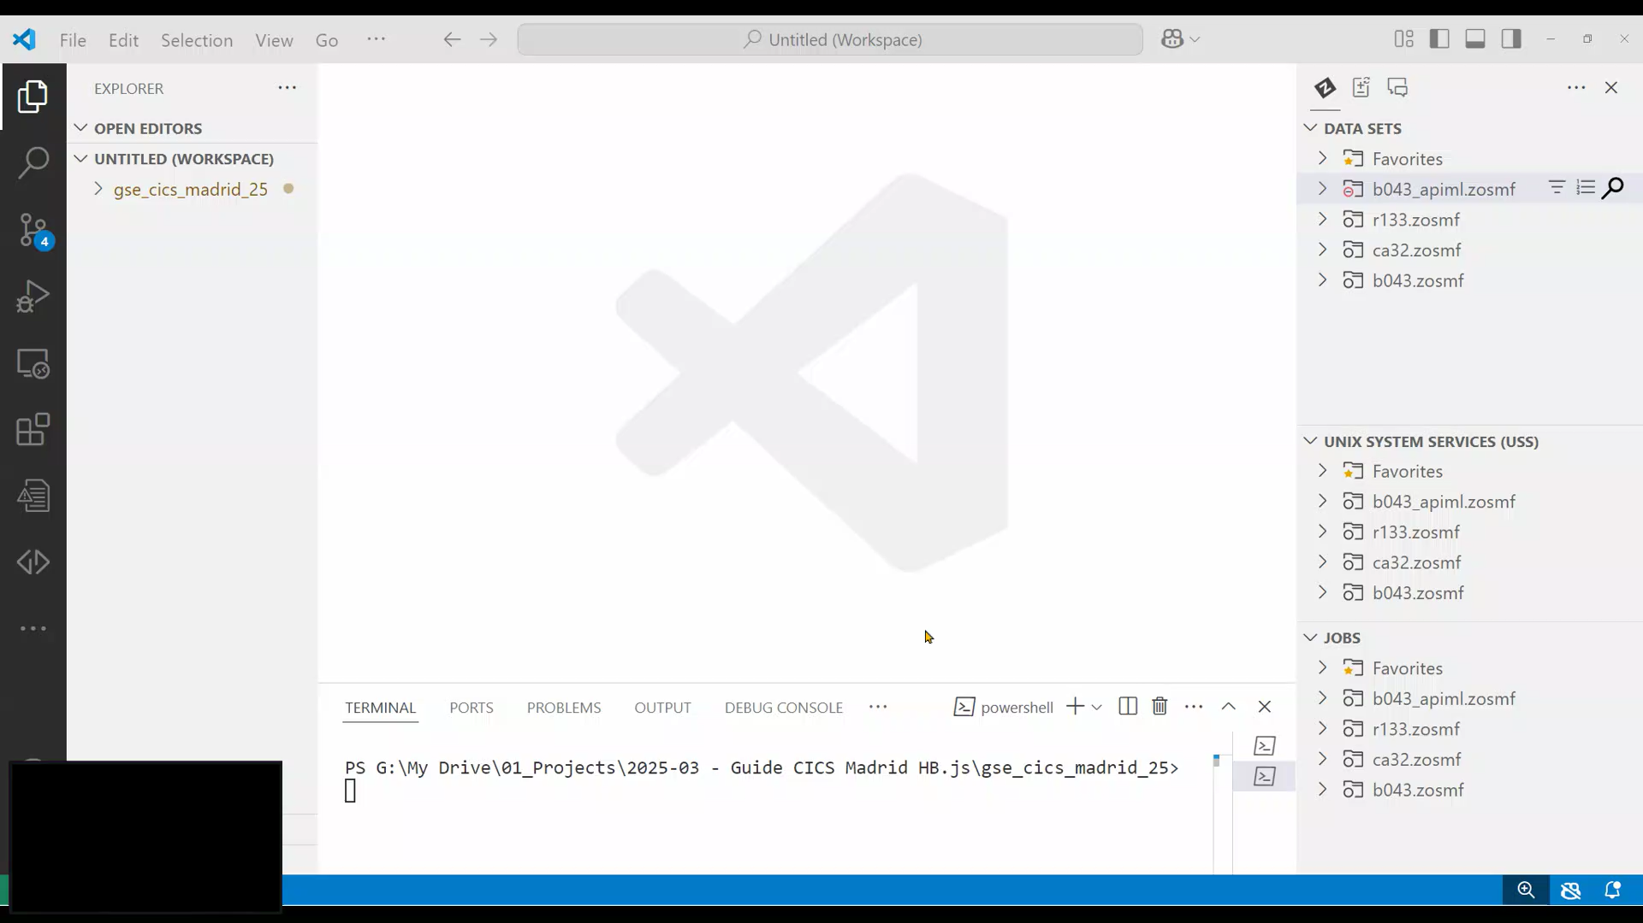

Slide 7
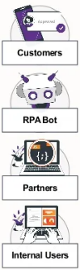
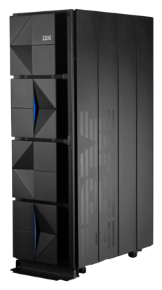
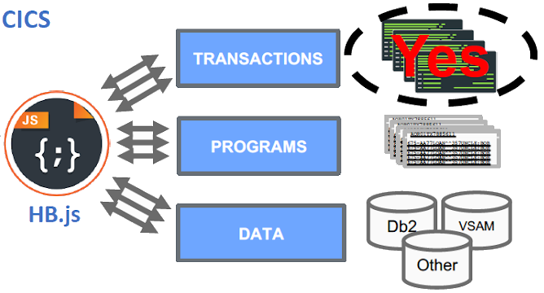

Remediation through Intelligent API Orchestration
Solution: HostBridge JavaScript Engine (HB.js)
Support for screen-oriented apps, CICS and data
HTTP/S
MQ
…
HB.js
Several orders of magnitude more efficient orchestration on z/OS platform running in zIIP
Notes:
What HostBridge is best known for is doing API orchestration on the platform.
We have the orchestration code running in CICS on the mainframe.
So what does that mean, Orchestration?
What this means without getting too much into the technical details. Think of a transaction.
If you ask a non mainframer…
transferring funds from one account to another, sure good answer.
However, us mainframers know…. That transactions are….
1 CICS transaction could be opening app, then another would be choosing a menu item.. So each of these is considered 1 transaction.
Transferring funds is a business process.
To accomplish a business objective, say. There are hundreds or thousands of transactions that need to occur in CICS behind the scenes.
With HB,js ,
We allow you to create a single business process service or REST API, that any external developer or consumer can use.
A developer calls the API, HB.js does the orchestration on the platform in CICS at machine speed, and on a ziPP, and sends back the request.
So to sum it up, instead of having off platform orchestration through RPA Bots, excel macros, integration layers, working through CICS with screen oriented transactions, one a 1 to 1 basis.. That’s one transaction at a time.
They will simply be able to make an A REST API call.
That Call will invoke a script, or service. That script will orchestrate the invocation of transactions, programs, and/or data sources to fulfill the request.
The response is then sent back to the requestor.
So, you have 1 request coming in, potentially thousands of transactions or data access running in CICS on a zIIP at machine speed, and then 1 response back. 1 to Many. Potentially reducing latency 95+ %
Also, HB.js allows for the ability for any program in CICS to use HB.js to make any external API call. This can be an internal service, or external in their Hybrid Cloud in AWS or azure…etc.
Its an API enablement product. All about Integration.

Slide 8

HostBridge JavaScript Engine (HB.js)
Integrate Everything! Create Business APIs for CICS apps in a non-disruptive way
No screen scraping
No application changes
No security changes
Efficient; low chatter
CUSTOMERS
CICS
RPA BOTS
{.js}
RESTful APIs
All CICS artifacts
Applications
Programs
Data
PARTNERS
Reduce inefficiencies in CICS application integrations by up to 95%
INTERNAL USERS
Code4z extension planned
Notes:
Consumers of these APIS can range from other business apps (e.g., front-ends), to bots, to 3rd party apps
These APIs are extremely efficient which helps to keep operating costs down
Today , we are seeing huge potential for AI-powered front-ends driving the transaction volume of your mainframe applications
If a demo is coming….
We will be showing how from within an IDE, and today we will be using VSCode to interface with the mainframe, you can design, build, test and deploy a REST API directly into CICS in minutes.
We are going to show from the start, an actual CICS application, and the panels within, all the way through to the fully functional API that can be consumed by any developer, or anyone off platform to create any front end!
All this with no changes to the code, no screen scraping, and fully scalable!

Slide 9
HB.js
VSCode Setup

Slide 10
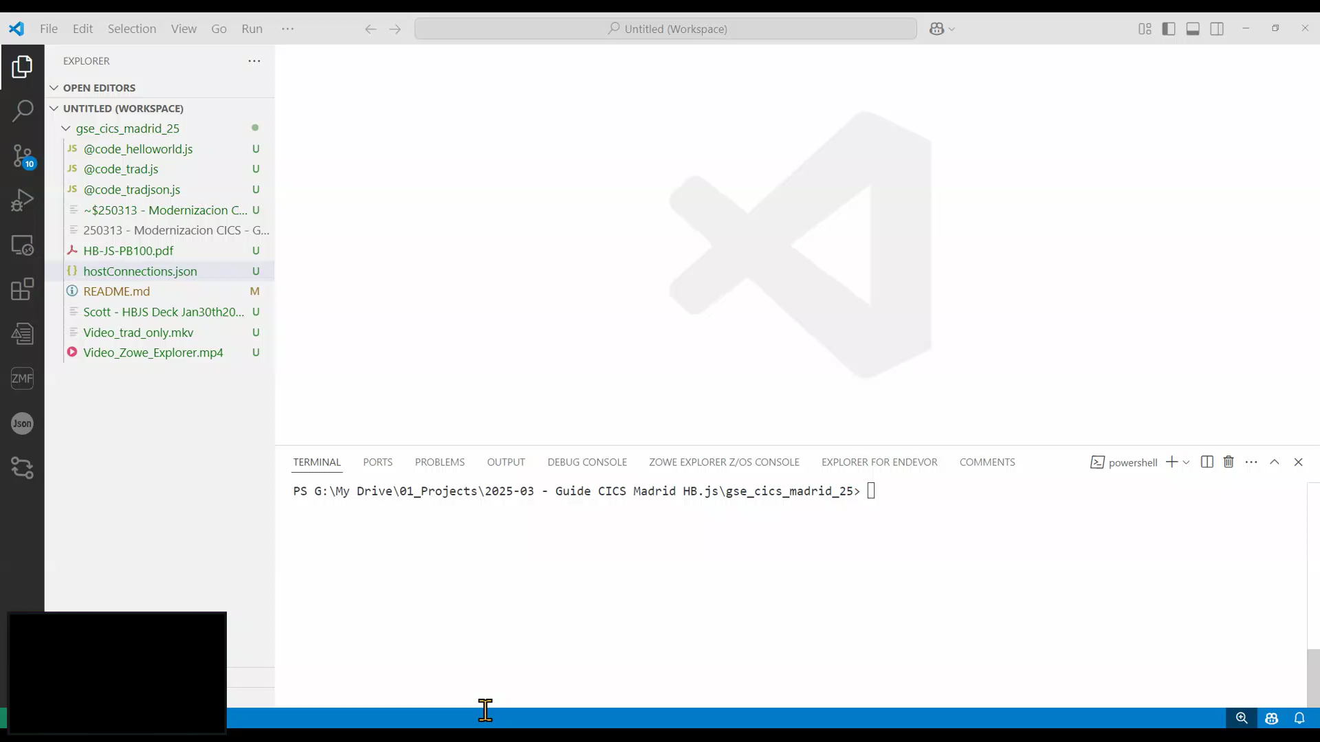

Slide 11
HB.js
Hello – Run – Put - Make

Slide 12
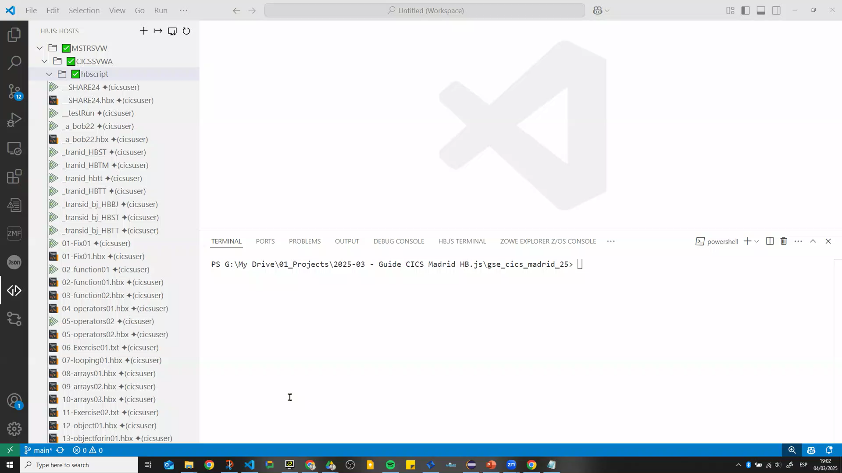

Slide 13
TRAD
IBM Demo Transaction

Slide 14


Slide 15
HB.js
Application Explorer

Slide 16
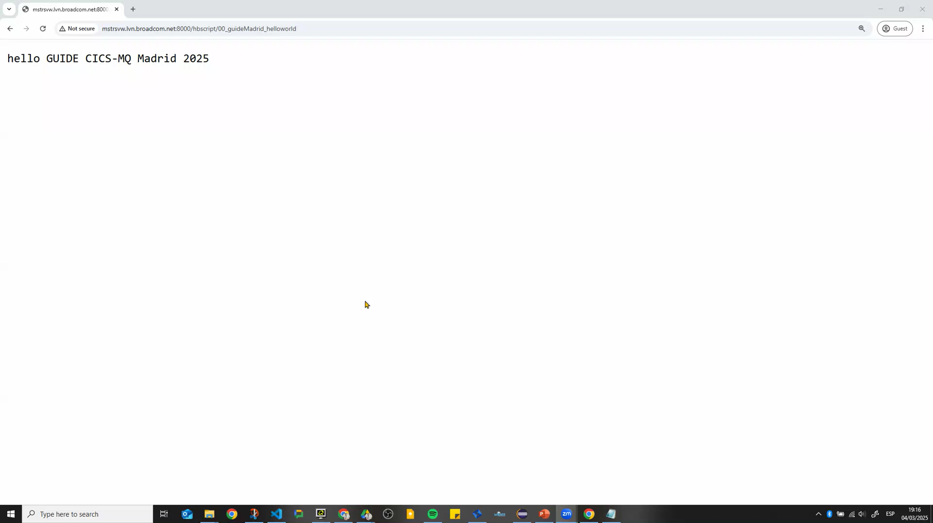

Slide 17
HB.js
Variable inputs – json response

Slide 18
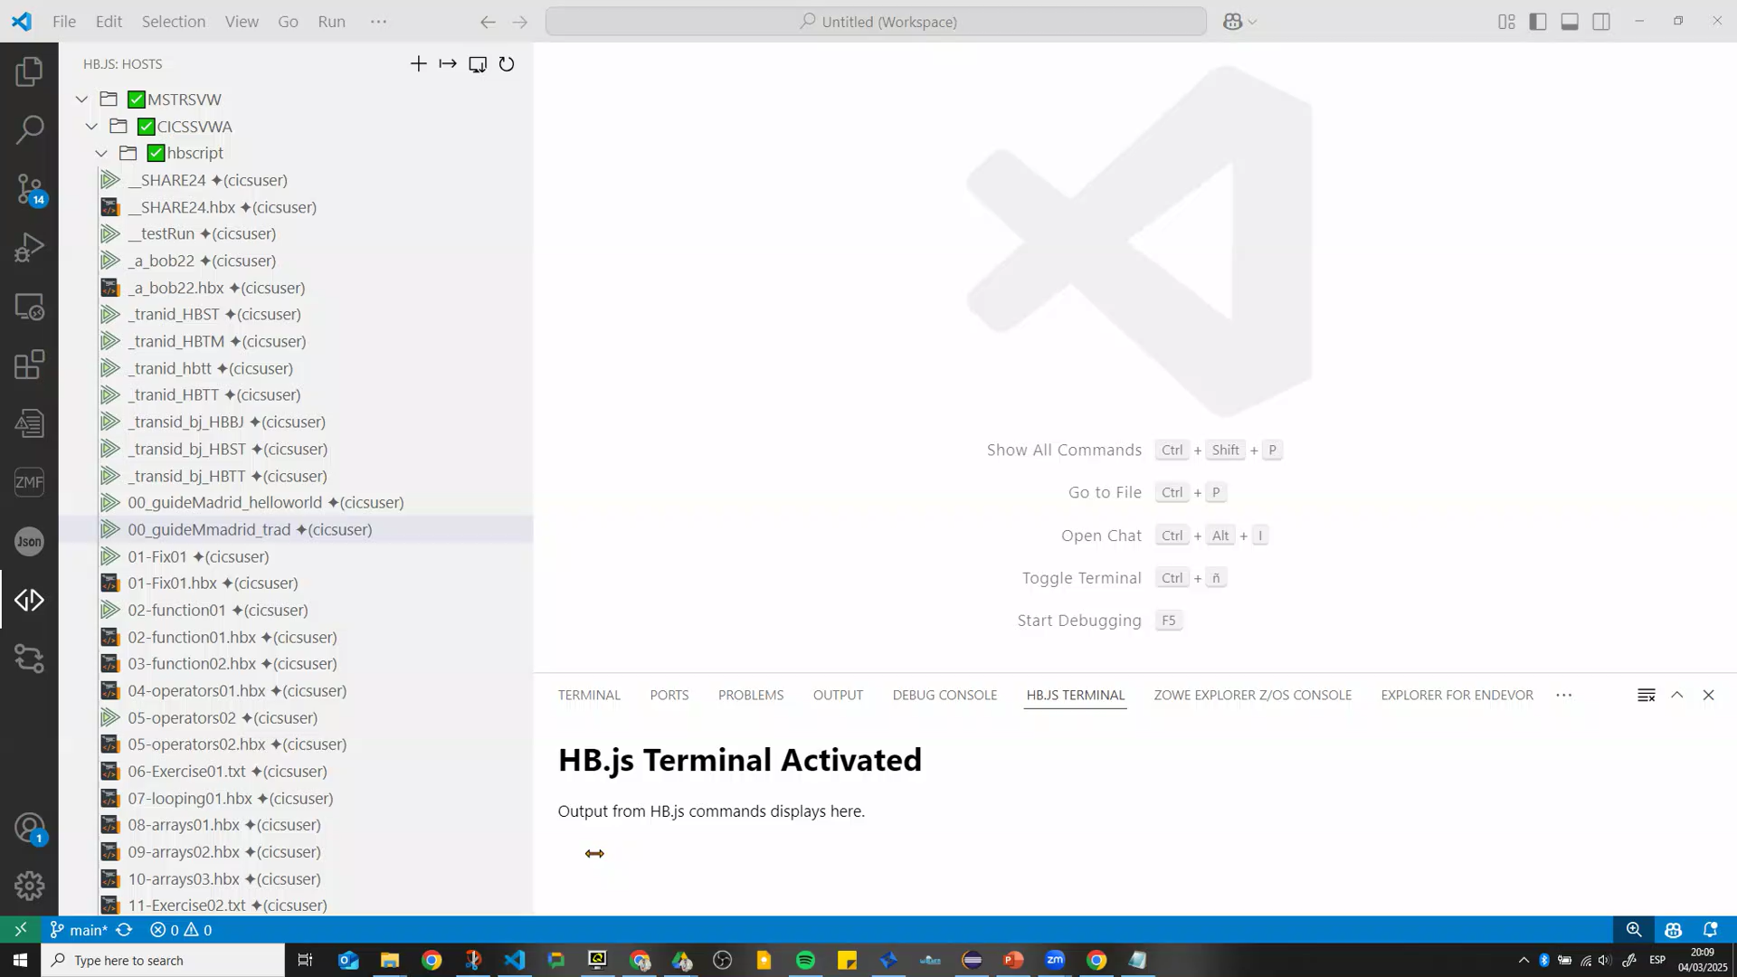

Slide 19
Gracias
Diego.rodriguez@broadcom.com

